Slide 1
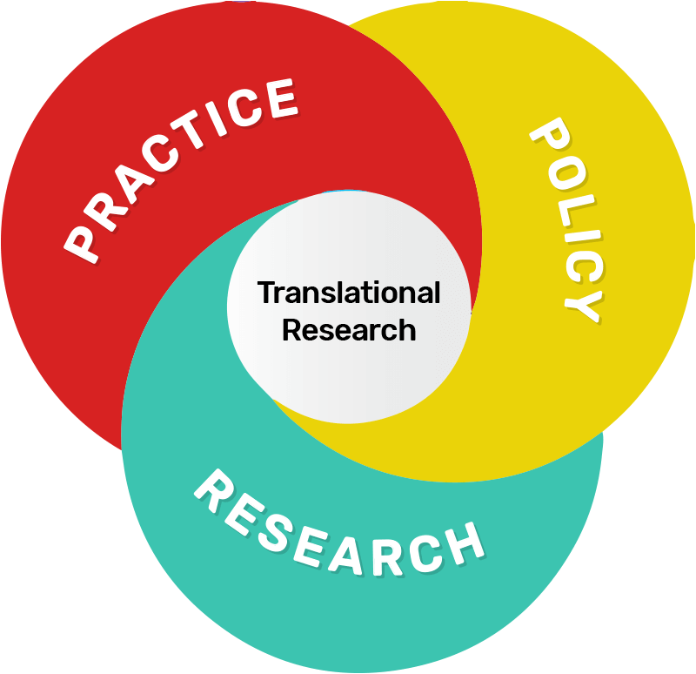
Translational Research

Slide 2
Syllabus
Applied research
Difference between applied and basic research,
necessity,
examples of applied research,
Advantages of applied research.
Industry sector
types of industry sector & classification of industry,
General concepts of industry,
Research & development in industry and types of R&D.
Industry and academic joint research – Bridging the gap.
Technology Readiness levels (TRL) and
Manufacturing Readiness levels (MRL).
Start-up Incubators - Concepts
start-up ecosystem-
government start-up initiatives
Intellectual Property Rights
Copy right laws –
Patent rights.

Slide 3
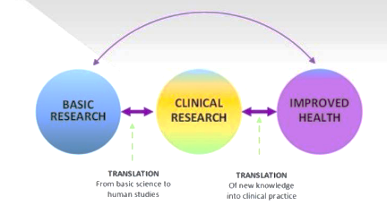
Translational research?
It is aimed at solving particular problems.
It involves the application of knowledge gained through basic research to studies that could support the development of new products.
Eg: In the field of medicine may involve using knowledge of the biology of a disease to identify and evaluate chemical compounds in disease models, with a view to selecting potential candidate drugs to advance into clinical trials.

Slide 4
Applied research
The pursuit of information that can be directly applied to practice is aptly known as applied research.
The goal of this research is to determine the applicability of theory and principles by testing hypotheses within specific settings.
Aptly= in a manner that is appropriate or suitable in the circumstances.
What is Applied Research?
Researchers in this field try to find immediate solutions to existing problems facing a society or an industrial or business organization.
The approach is much more useful as it strives to find information that will directly influence practice.
Strives= make great efforts to achieve or obtain something.
People cannot foresee the future well enough to predict what is going to develop from basic research. If we only did apply research, we would still be making better spears.
The needs of social action inspire applied research. It aims at finding a practical solution for an immediate problem of the society making optimal use of the available resources.

Slide 5
The problem-solving nature of applied research means it is conducted to reveal answers to specific questions related to action, performance, or policy needs.
In contrast to pure research, applied research entails large-scale studies with subsequent data collection problems.
Applied research is designed to solve practical problems of the modern world, rather than to acquire knowledge for knowledge’s sake.
One might legitimately say that the goal of applied research is to improve human conditions.
legitimately = In a way that can be defended with logic or justification; fairly
For example, applied researchers may investigate ways and means to:
Improve agricultural crop production;
Treat or cure a specific disease;
Improve the energy efficiency of homes, offices, or modes of transportation;
Suggest innovative and modified methods of measurement in any specific investigation.

Slide 6
ome scientists feel that the time has come for a shift in emphasis away from purely basic research toward applied research for the sake of the human population.
This trend, they feel, is necessitated by the problems resulting from global overpopulation, pollution, and the overuse of the earth’s natural resources.
In recent years, applied research, under the banner of operations research, has extensive applications in health and family planning programs to identifying problems and designing and evaluating policies and programs that will deliver the most significant benefit at an affordable cost.
In social sciences, research is often a mixture of both basic and applied; some stages of a study may have a basic flavor, while other stages may be more applied.

Slide 7
Examples of Applied Research-Case study
Example #1
Eclampsia is a major cause of maternal mortality in Bangladesh.
From the clinical observations in Bangladesh and elsewhere, it is observed that the early cesarean section may nullify the violent effect of this grave disease.
To date, no such study has been undertaken in our country. It is proposed that a comparative study between Caesarean section and Vaginal delivery in Eclamsia be undertaken.
The study will help to reduce the maternal and prenatal mortality considerably and thus improve our health status.
Eclampsia is a severe complication of preeclampsia. It's a rare but serious condition where high blood pressure results in seizures during pregnancy. Seizures are periods of disturbed brain activity that can cause episodes of staring, decreased alertness, and convulsions (violent shaking).
Example #2
It has been observed that in Bangladesh, the proportion of women who are delivered through Caesarean section is very high.
It is suspected that a small height is one of the risk factors for difficult deliveries. A study may, therefore, be conducted to verify if this proposition is true.

Slide 8
Example #3
Based on Hakim (1994) study findings, that Bangladeshi ethnic entrepreneurs were not sufficiently aware of the advisory services and assistance provided by different organizations.
Those who were aware they did not fully utilize these services.
Different Kinds of Research
Applied research is one type of research that is used to answer a specific question that has direct applications to the world. This is the type of research that solves a problem. We will look at an example later.
Basic research is another type of research, and it is driven purely by curiosity and a desire to expand our knowledge. This type of research tends not to be directly applicable to the real world in a direct way, but enhances our understanding of the world around us. So, the real difference between the two types of research is what they will be used for. Will the research be used to help us understand a real world problem and solve it, or will the research further our general information?

Slide 9
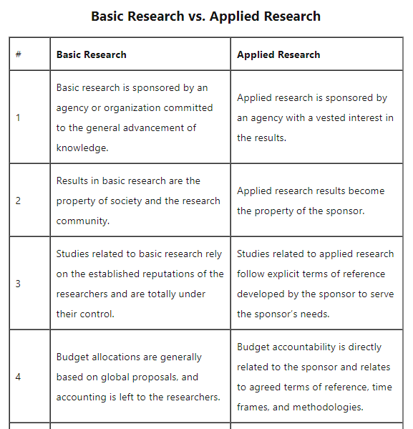

Slide 10
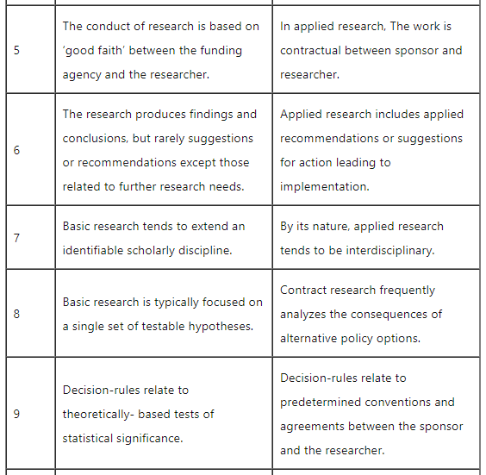

Slide 11
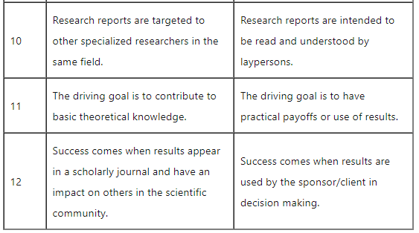

Slide 12
Necessity
Applied research refers to scientific study and research that seeks to solve practical problems.
This type of research plays an important role in solving everyday problems that often have an impact on life, work, health, and overall well-being.
This type of research can be used in a variety of ways.
For example, it is used to find solutions to everyday problems, cure illness, and develop innovative technologies.
There are many different types of psychologists who perform applied research. Psychologists working in human factors or industrial/organizational fields, for example, often do this type of research.
Analyzing what type of prompts will inspire people to volunteer their time to charities
Investigating if background music in a work environment can contribute to greater productivity
Investigating which treatment approach is the most effective for reducing anxiety
Researching which strategies work best to motivate workers

Slide 13
